Slide 1
2023 North Pacific SWO assessment
ISC BILLWG
Slides updated as work progresses

Slide 2
Modeling Team Meeting I
Jan 17/18, 2023

Slide 3
Status Update
Organization:
Github
Quarto
Goal is to make the assessments transparent, easily replicated/modified in future years, and easy to onboard new BILLWG members
No more emailing SS3 input files ☺
Development Progress
Data in – model version 3.30.20
Model converges/hessian inverts
Population biomass unrealistic (10²³)
Dropped JPN EPO size comp (sample size)
Separated US LL Deep size comp – sex specific length as its own fleet
Still considering aggregating all size comp or dropping fleet entirely

Slide 4
02/21/23 Status Update
Current actively updated model
Progress:
Model converges
Positive definite Hessian
Gradient <0.0001
Fits data reasonably/no parameters on the bounds
Initial equilibrium catch likelihood problem
Dropped JPN CODF size data
IATTC size data double normal selectivity (was asymptotic lognormal)
Removed sex-specific size data
Next steps
3. Add back in sex-specific data
2. Use likelihood profile to explore dropping/down-weighting size comp or CPUE indices
1. Adding a few blocks to improve fit to size comp
Continue trying to solve initial equilibrium catch likelihood
For future model development:
2-area model with tagging data
Explore an environmental index for recruitment?

Slide 5
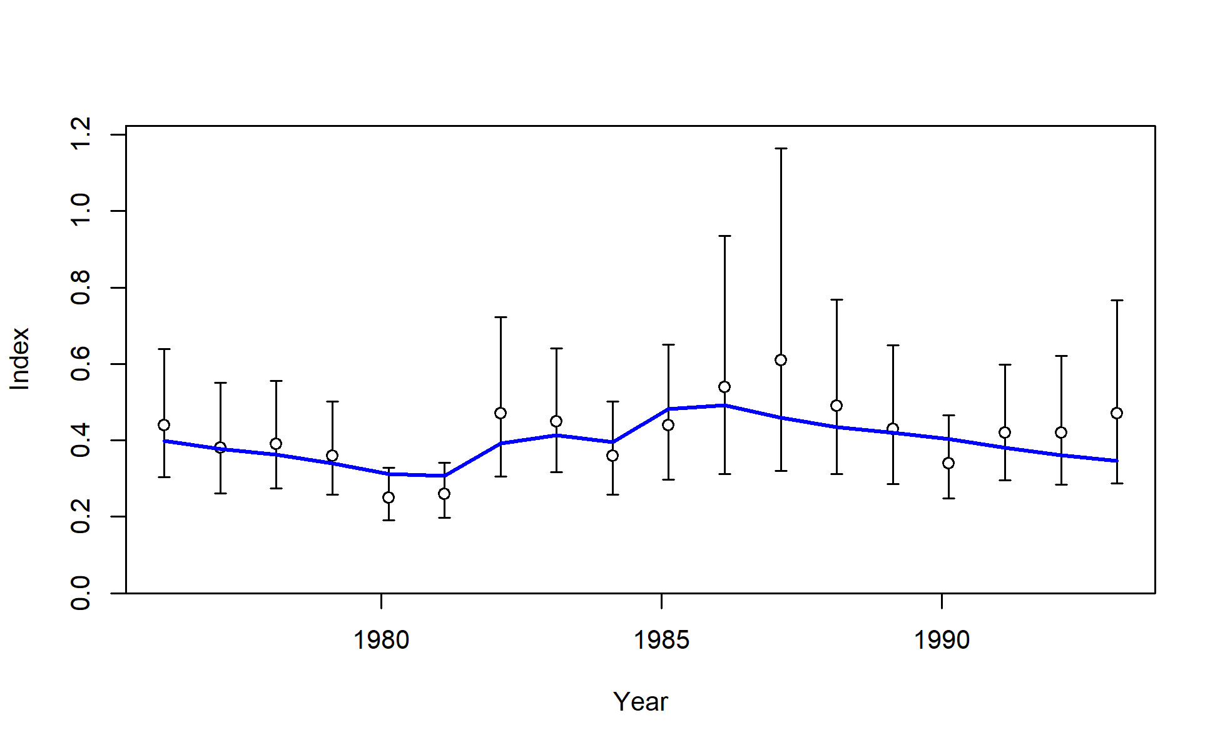
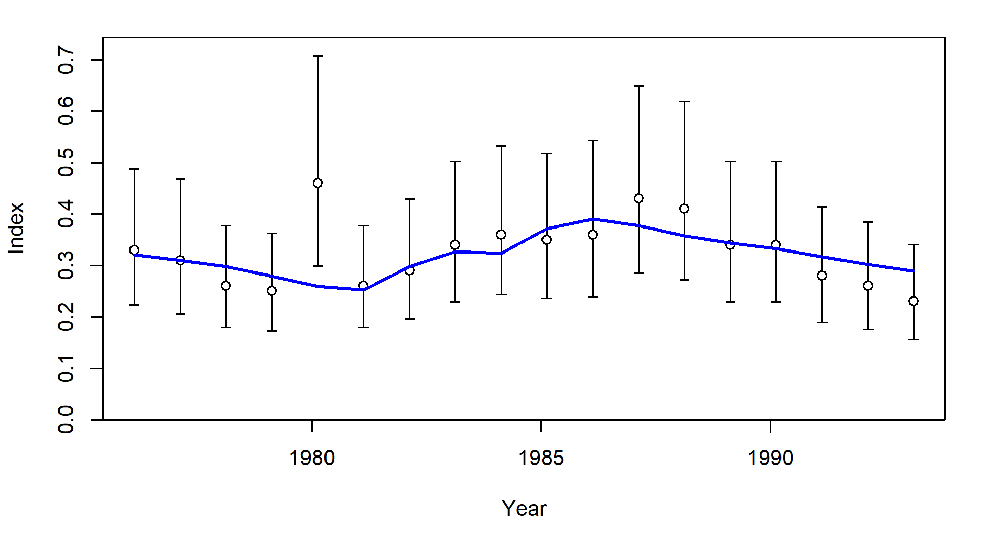
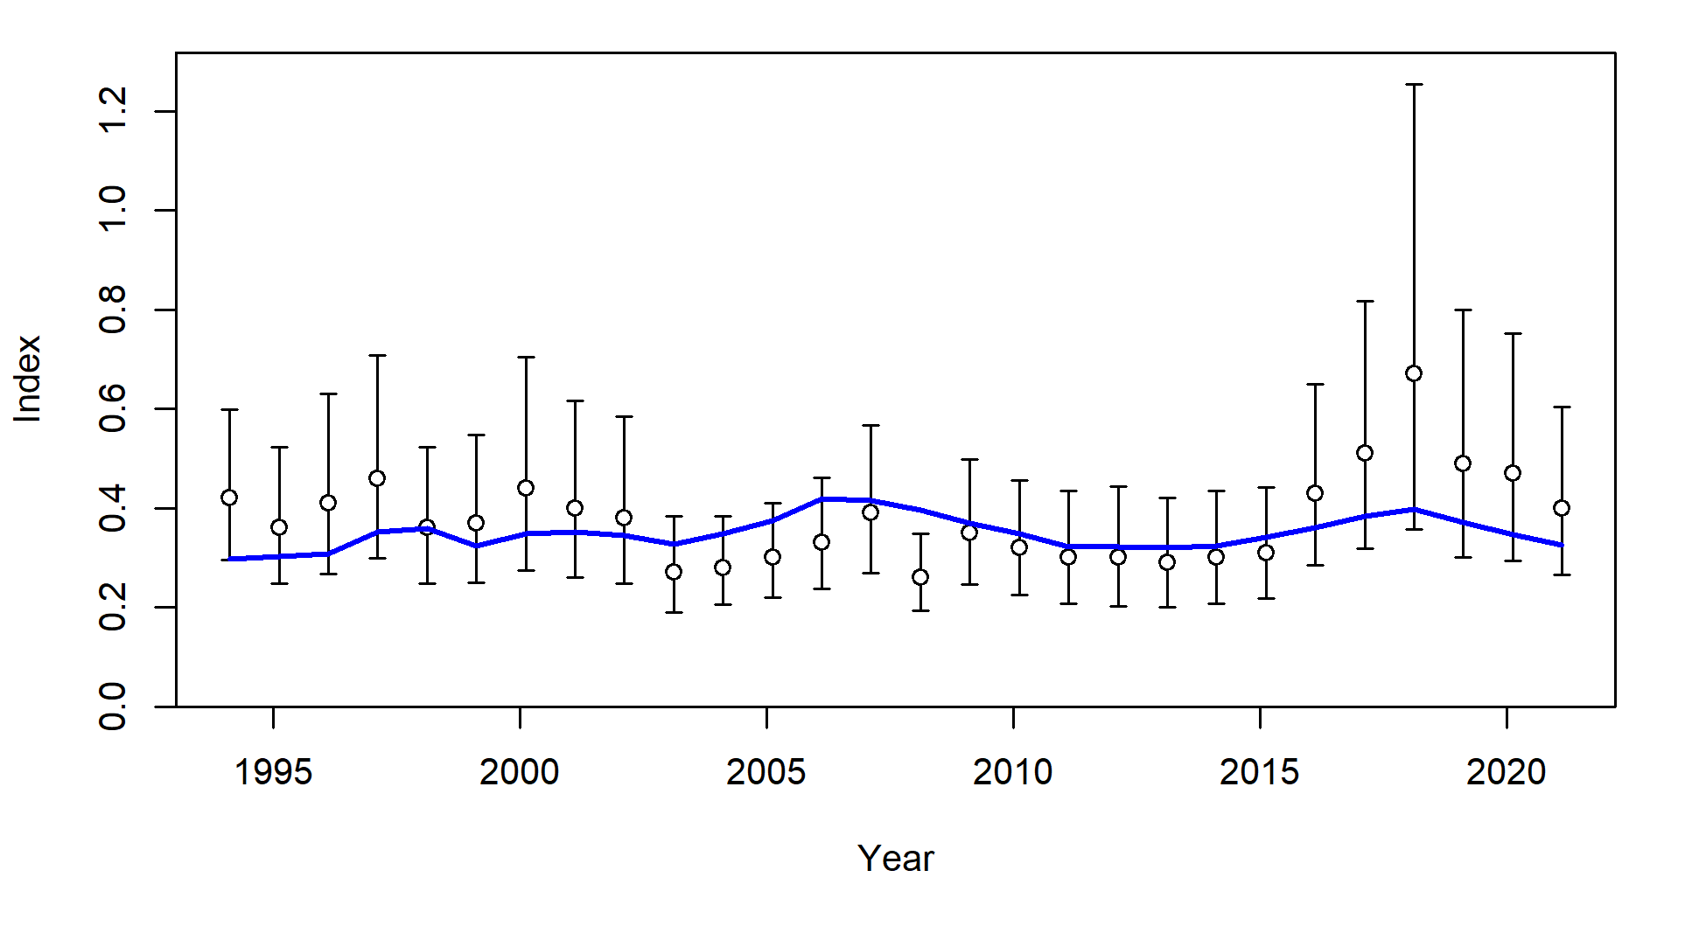
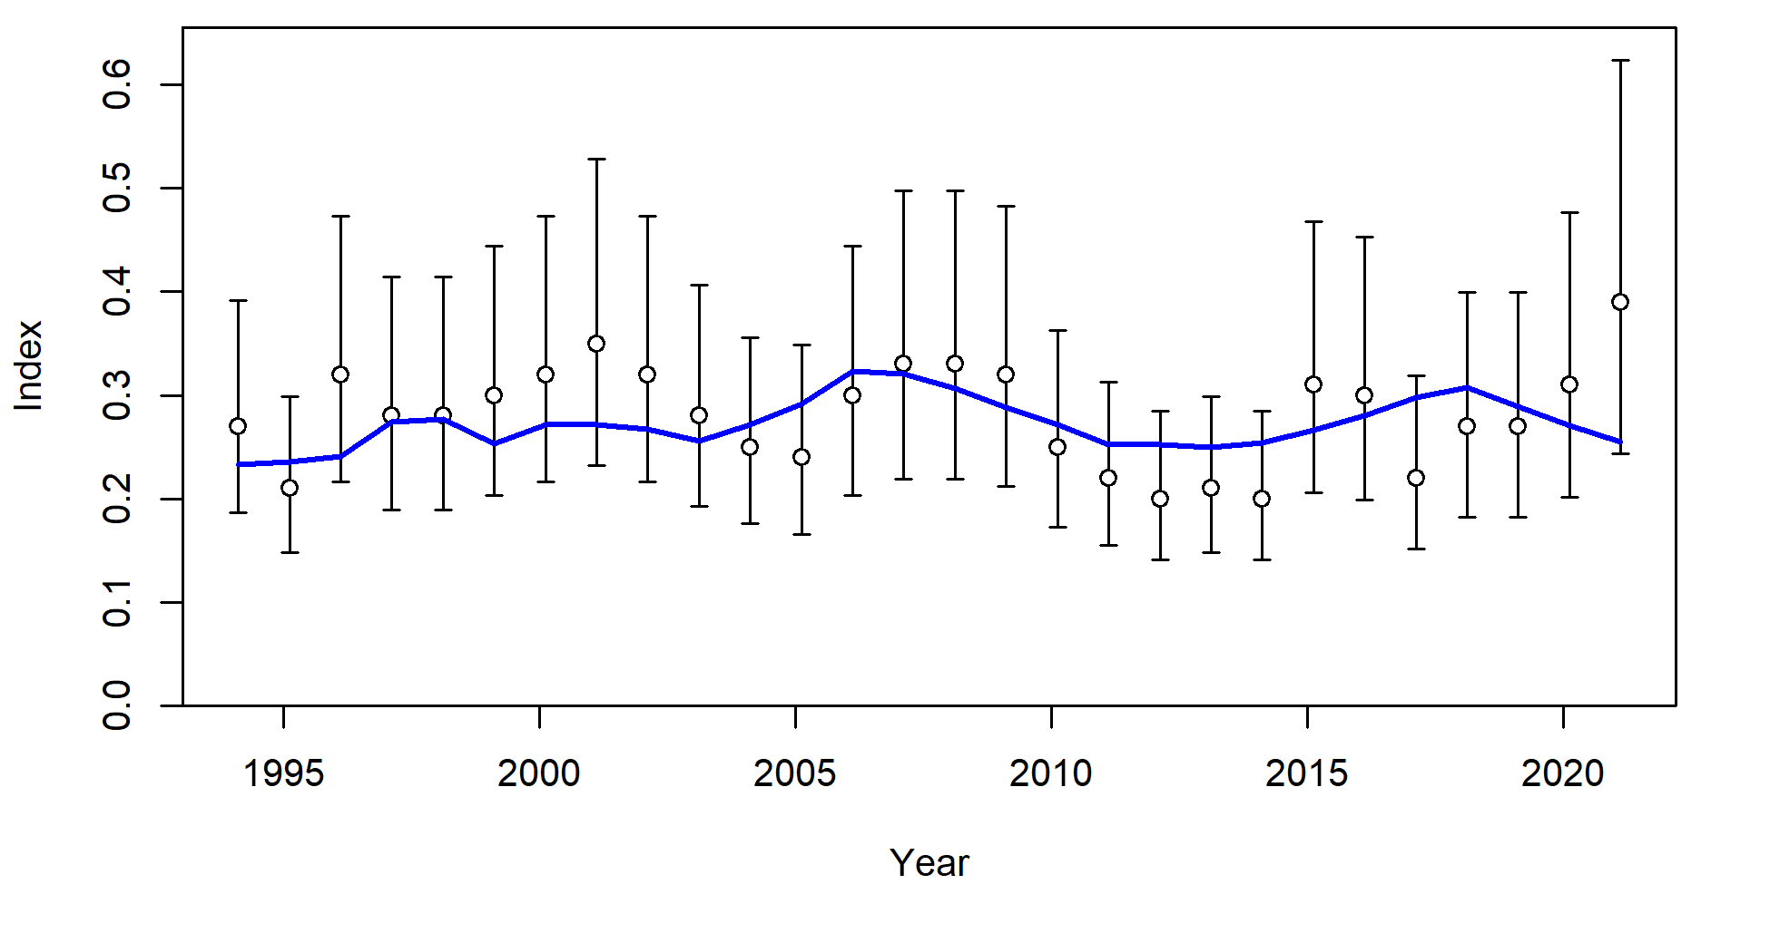
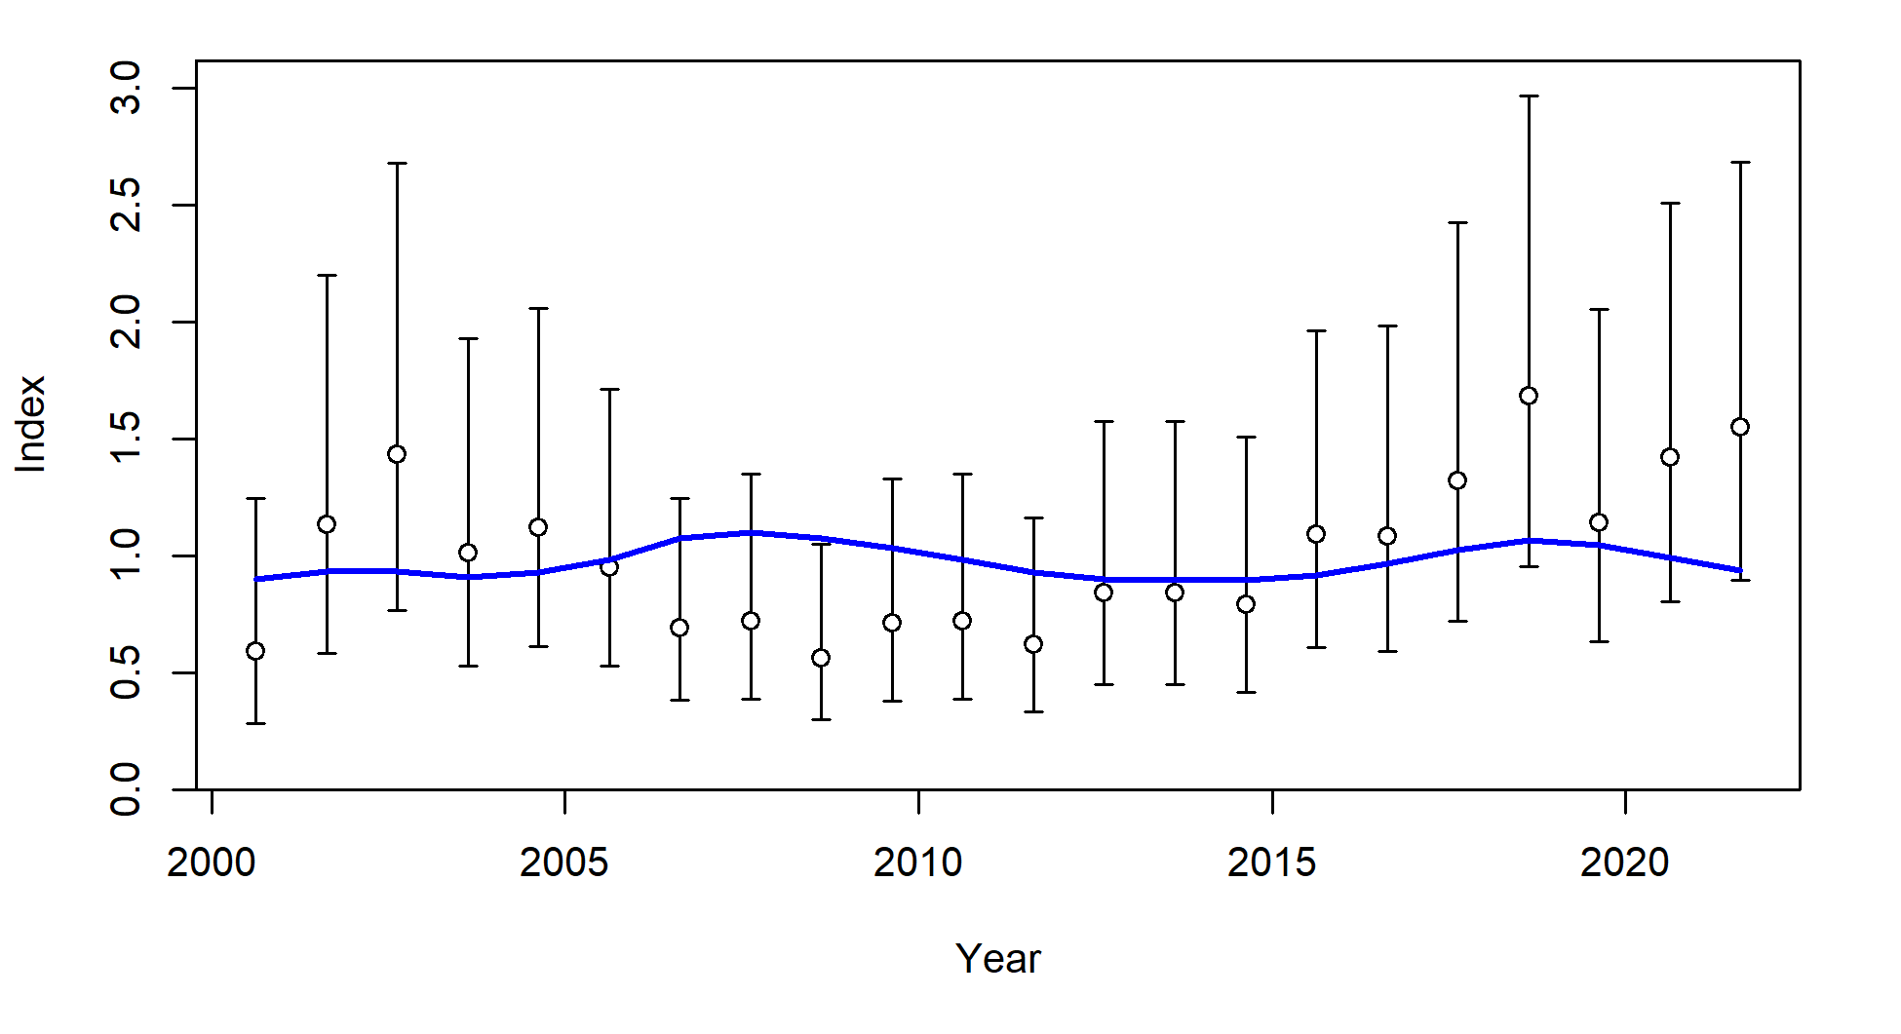
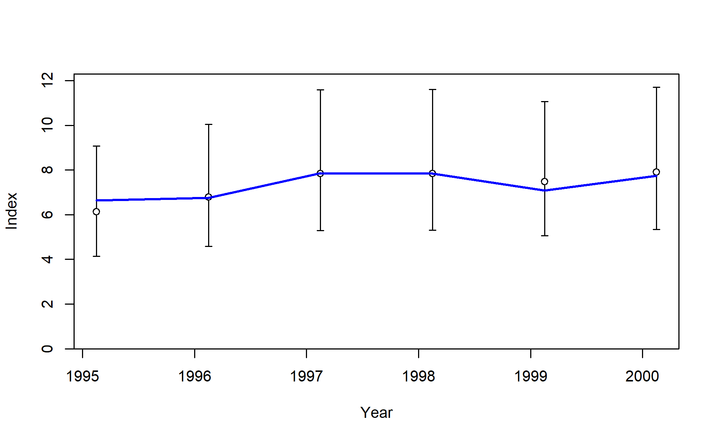
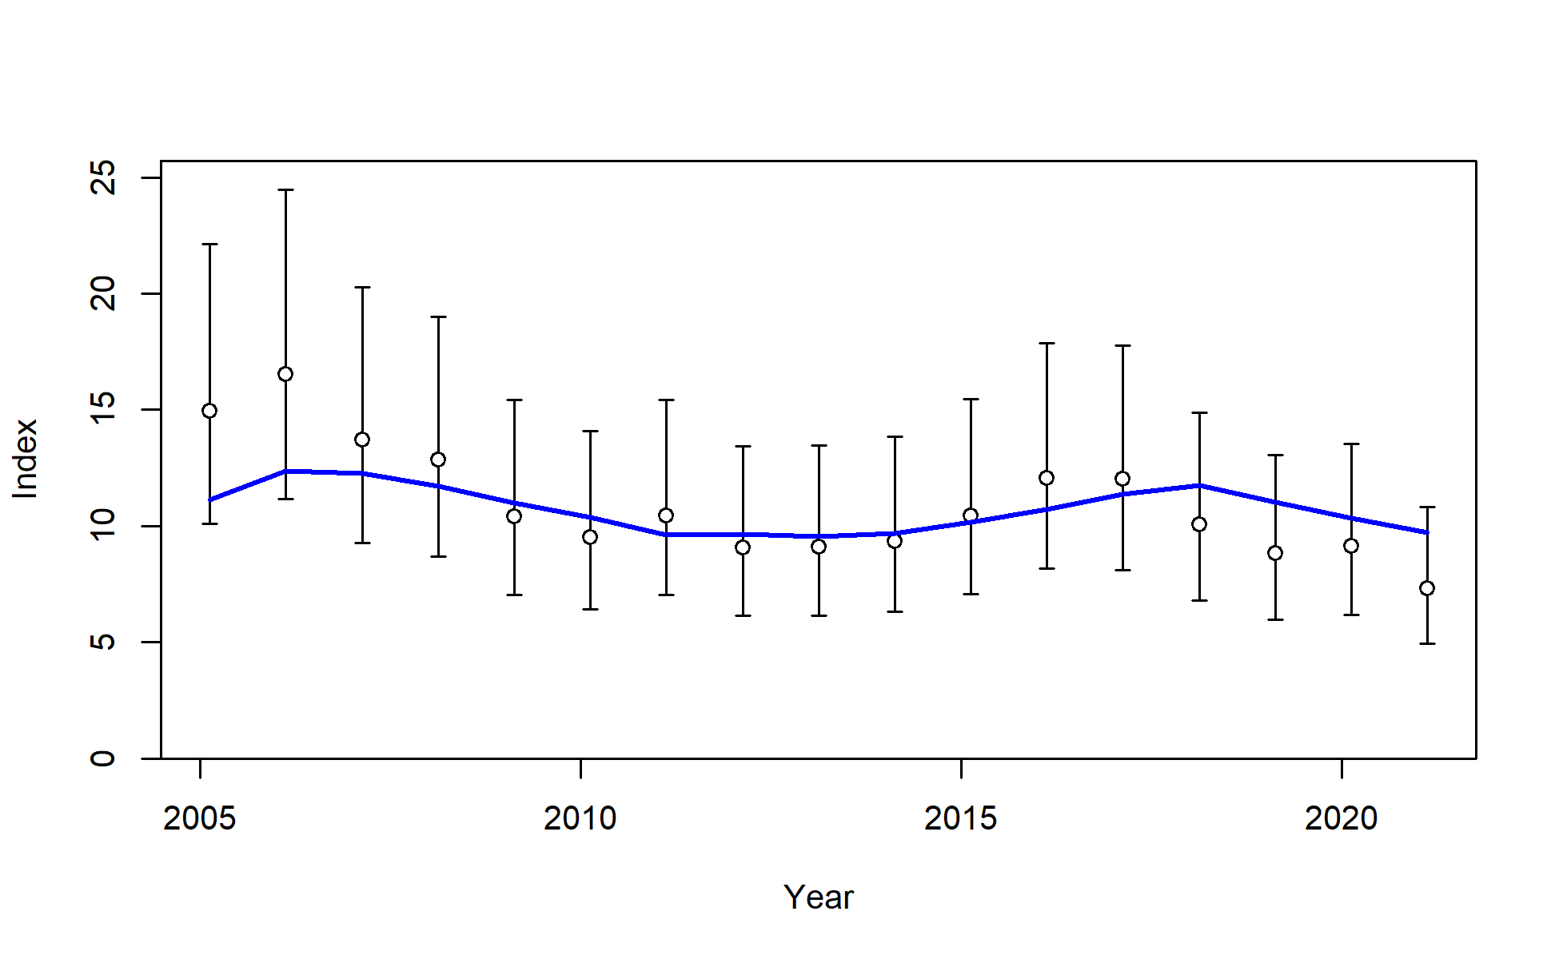
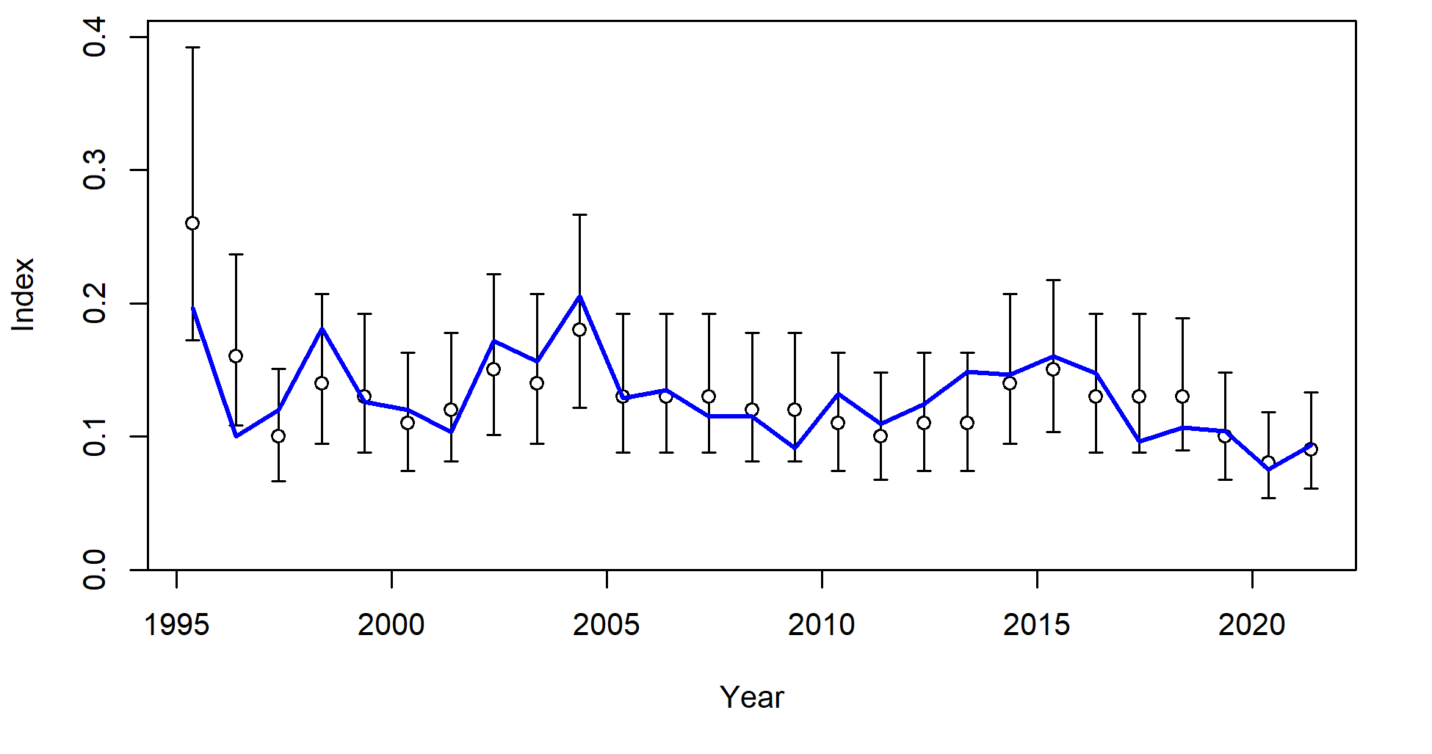
S1_JPN_WCNPO_OSDWLL_early_Area1
S2_JPN_WCNPO_OSDWCOLL_late_Area1
S3_JPN_WCNPO_OSDWLL_early_Area2
S4_JPN_WCNPO_OSDWLL_late_Area2
S5_TWN_WCNPO_DWLL_late
S8_US_WCNPO_LL_shallow_late
S6_US_WCNPO_LL_deep
S7_US_WCNPO_LL_shallow_early

Slide 6
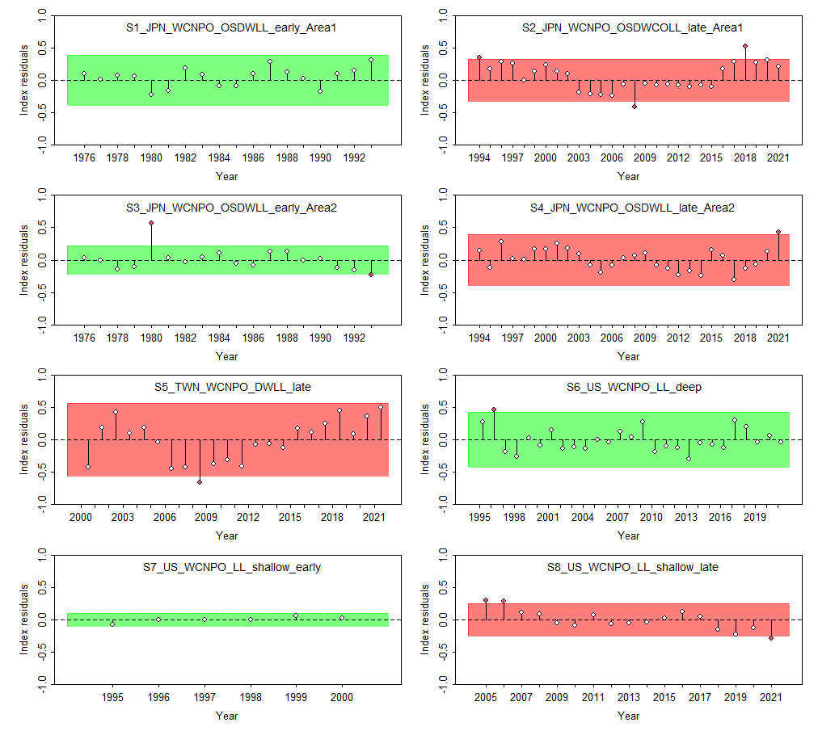

Slide 7
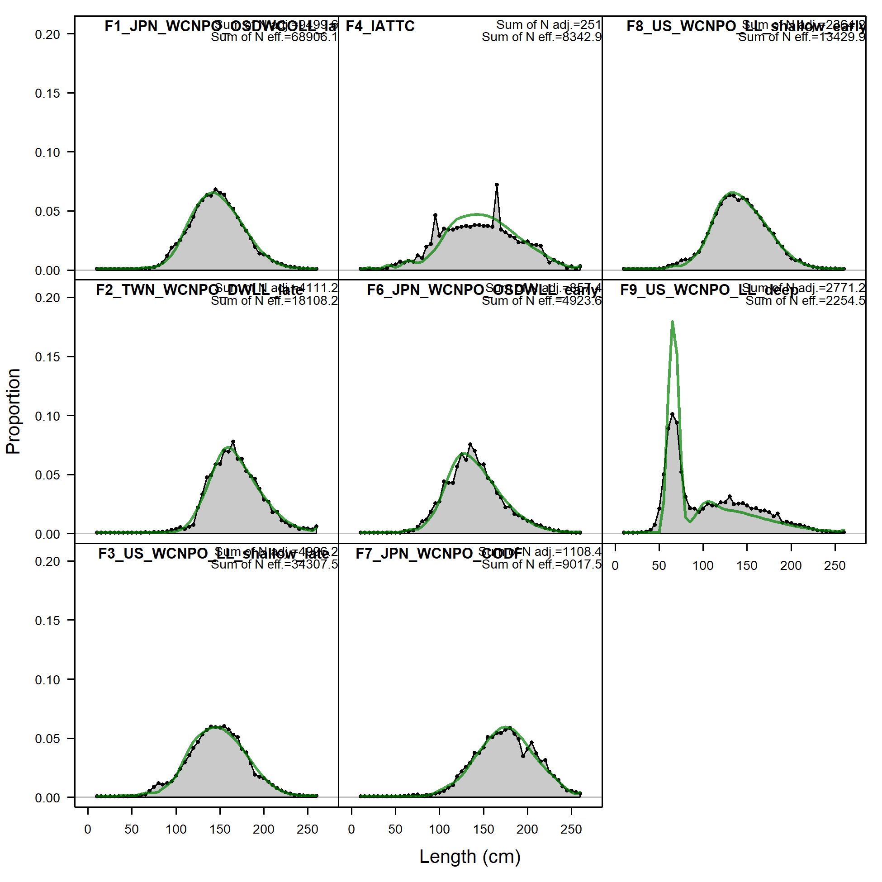

Slide 8
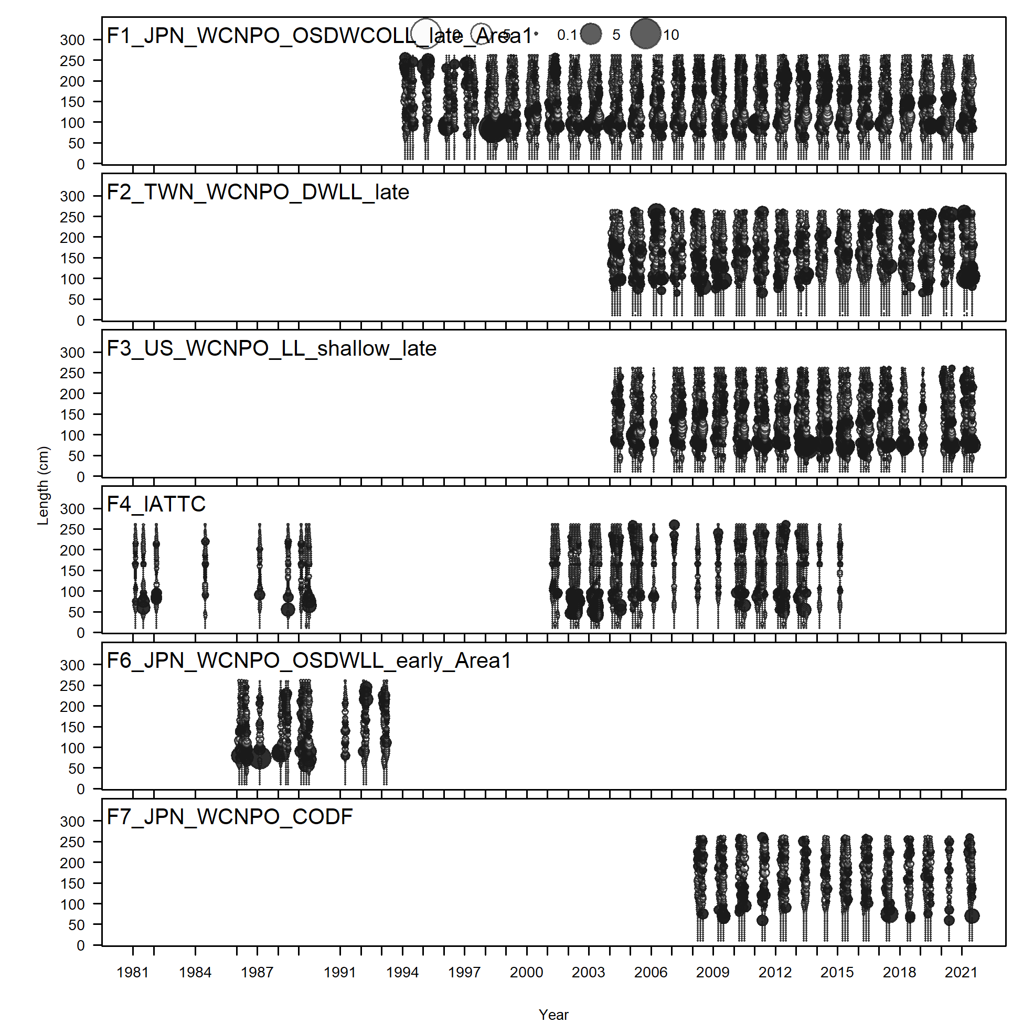
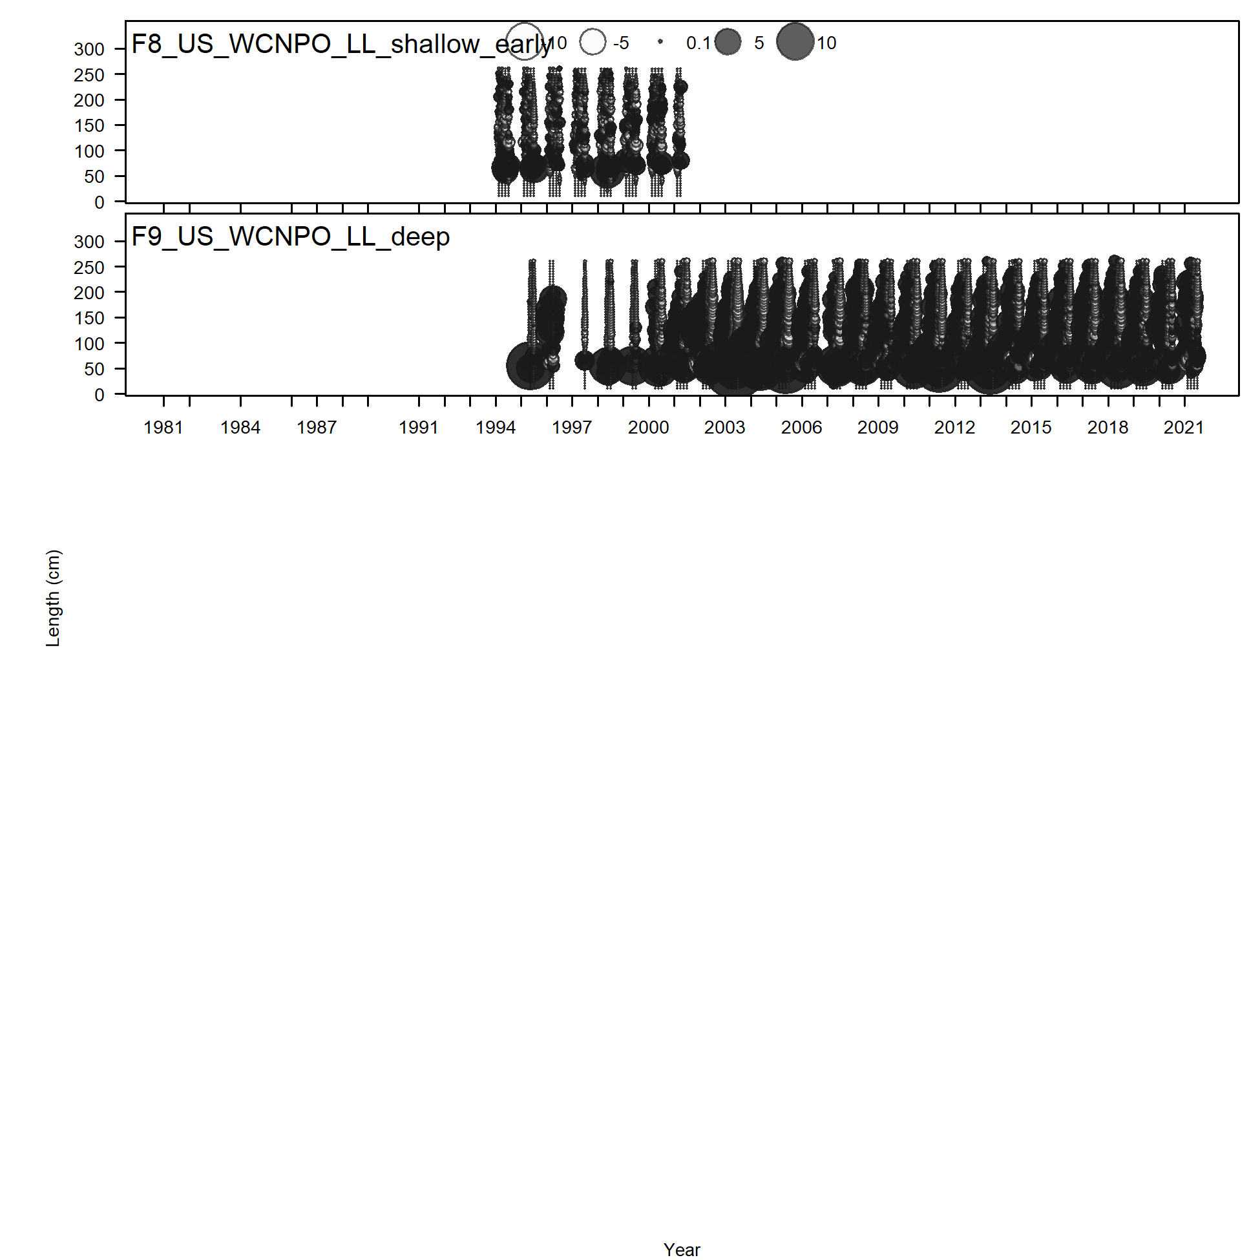

Slide 9
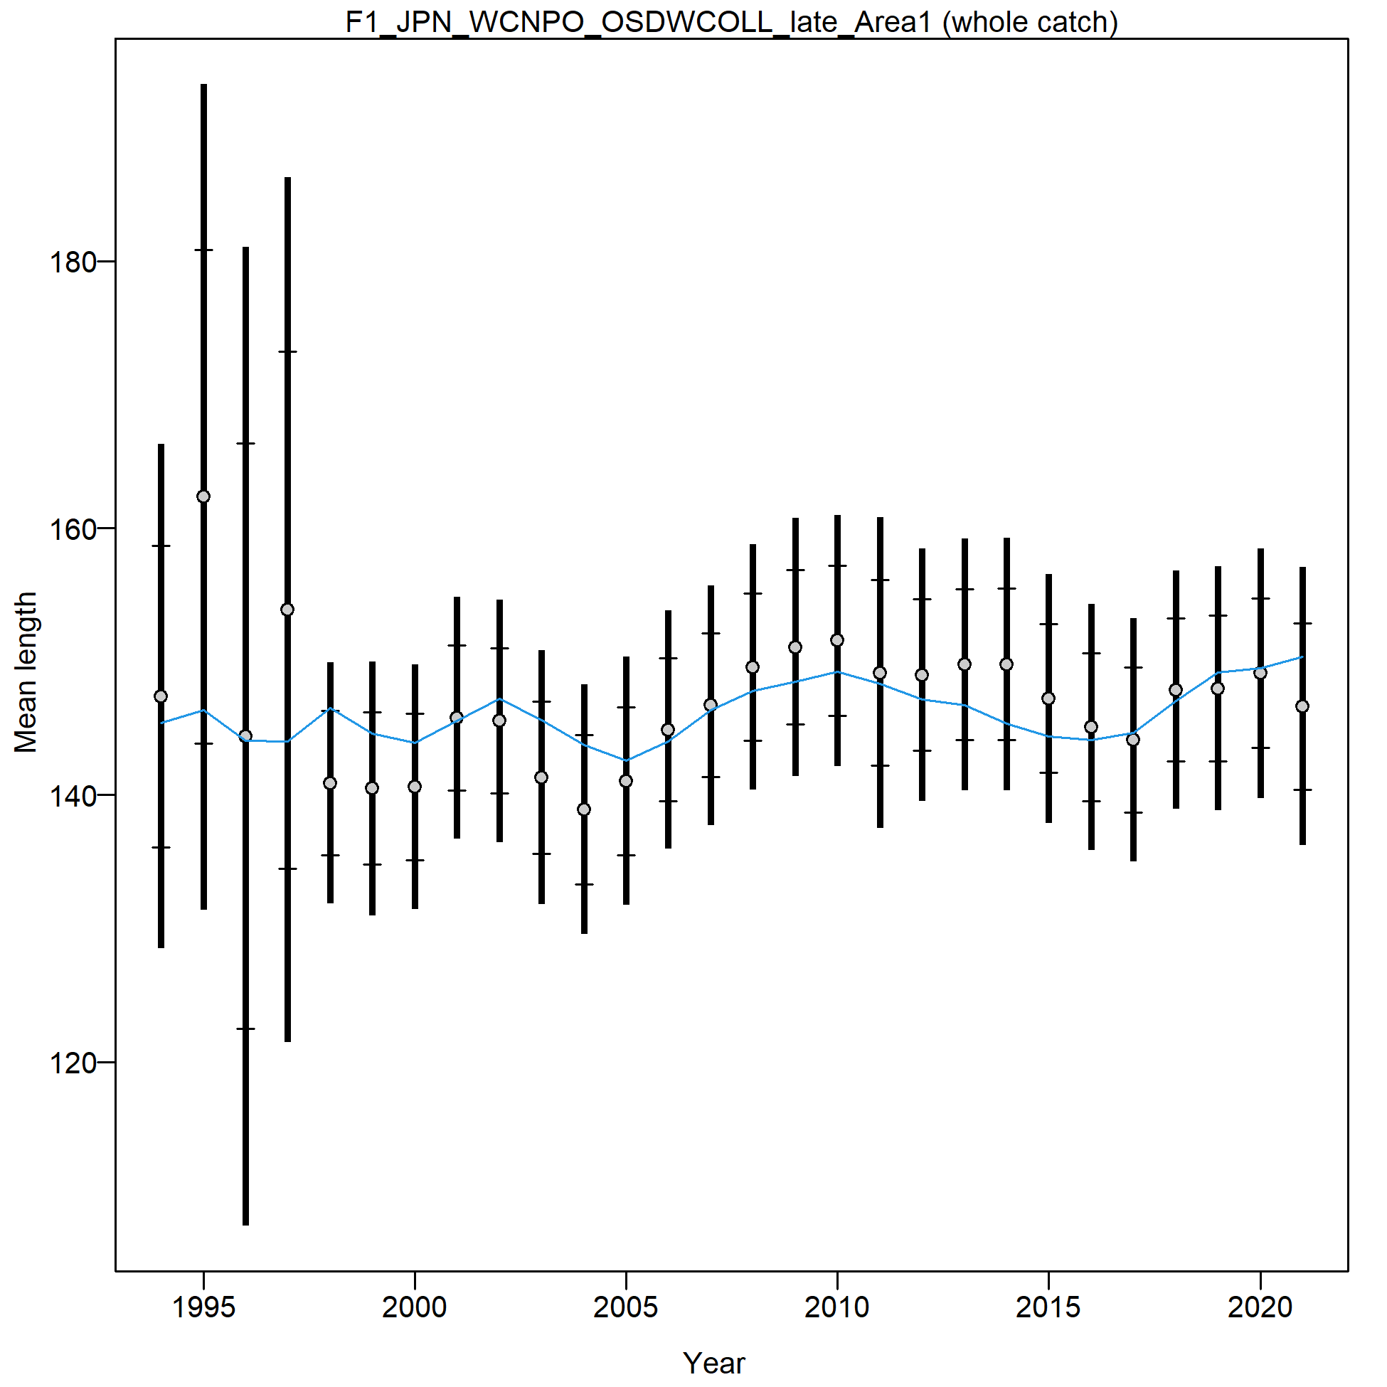
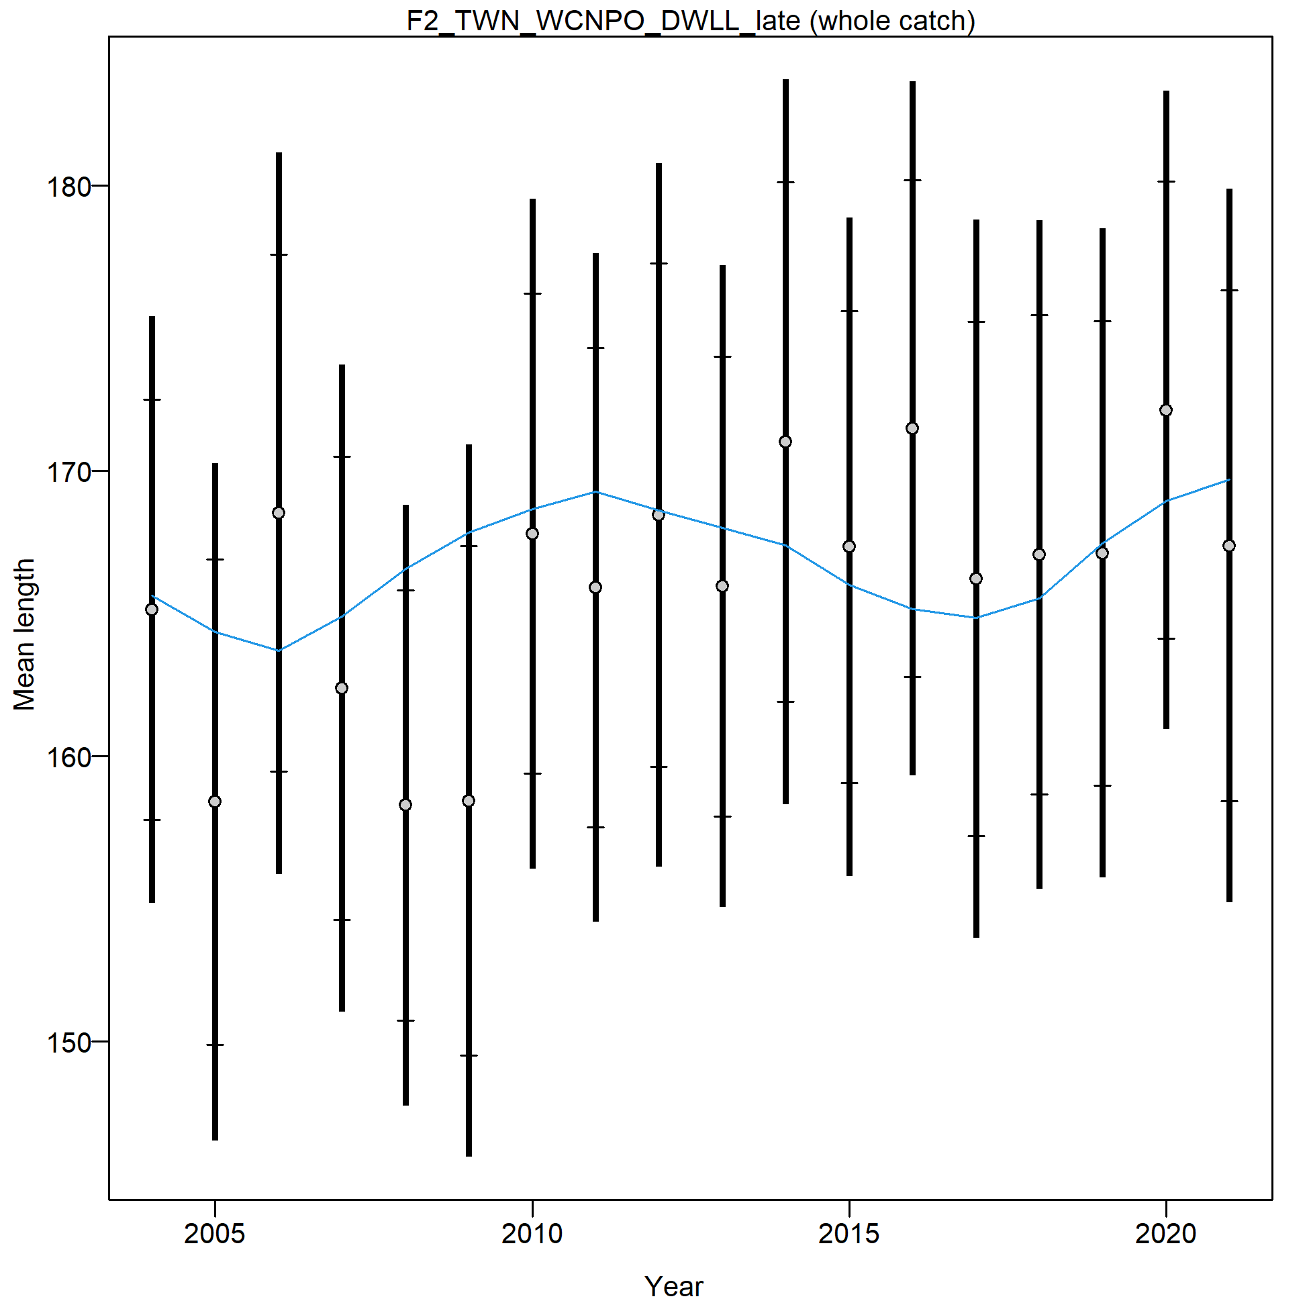
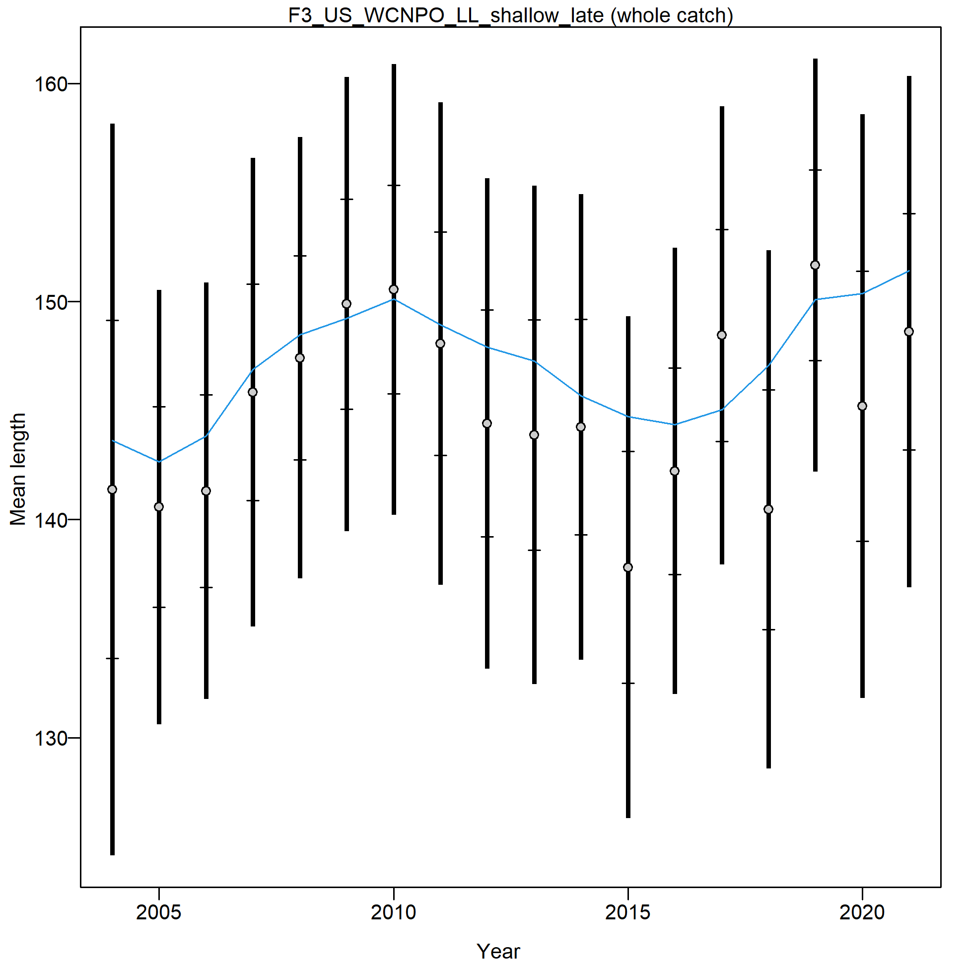
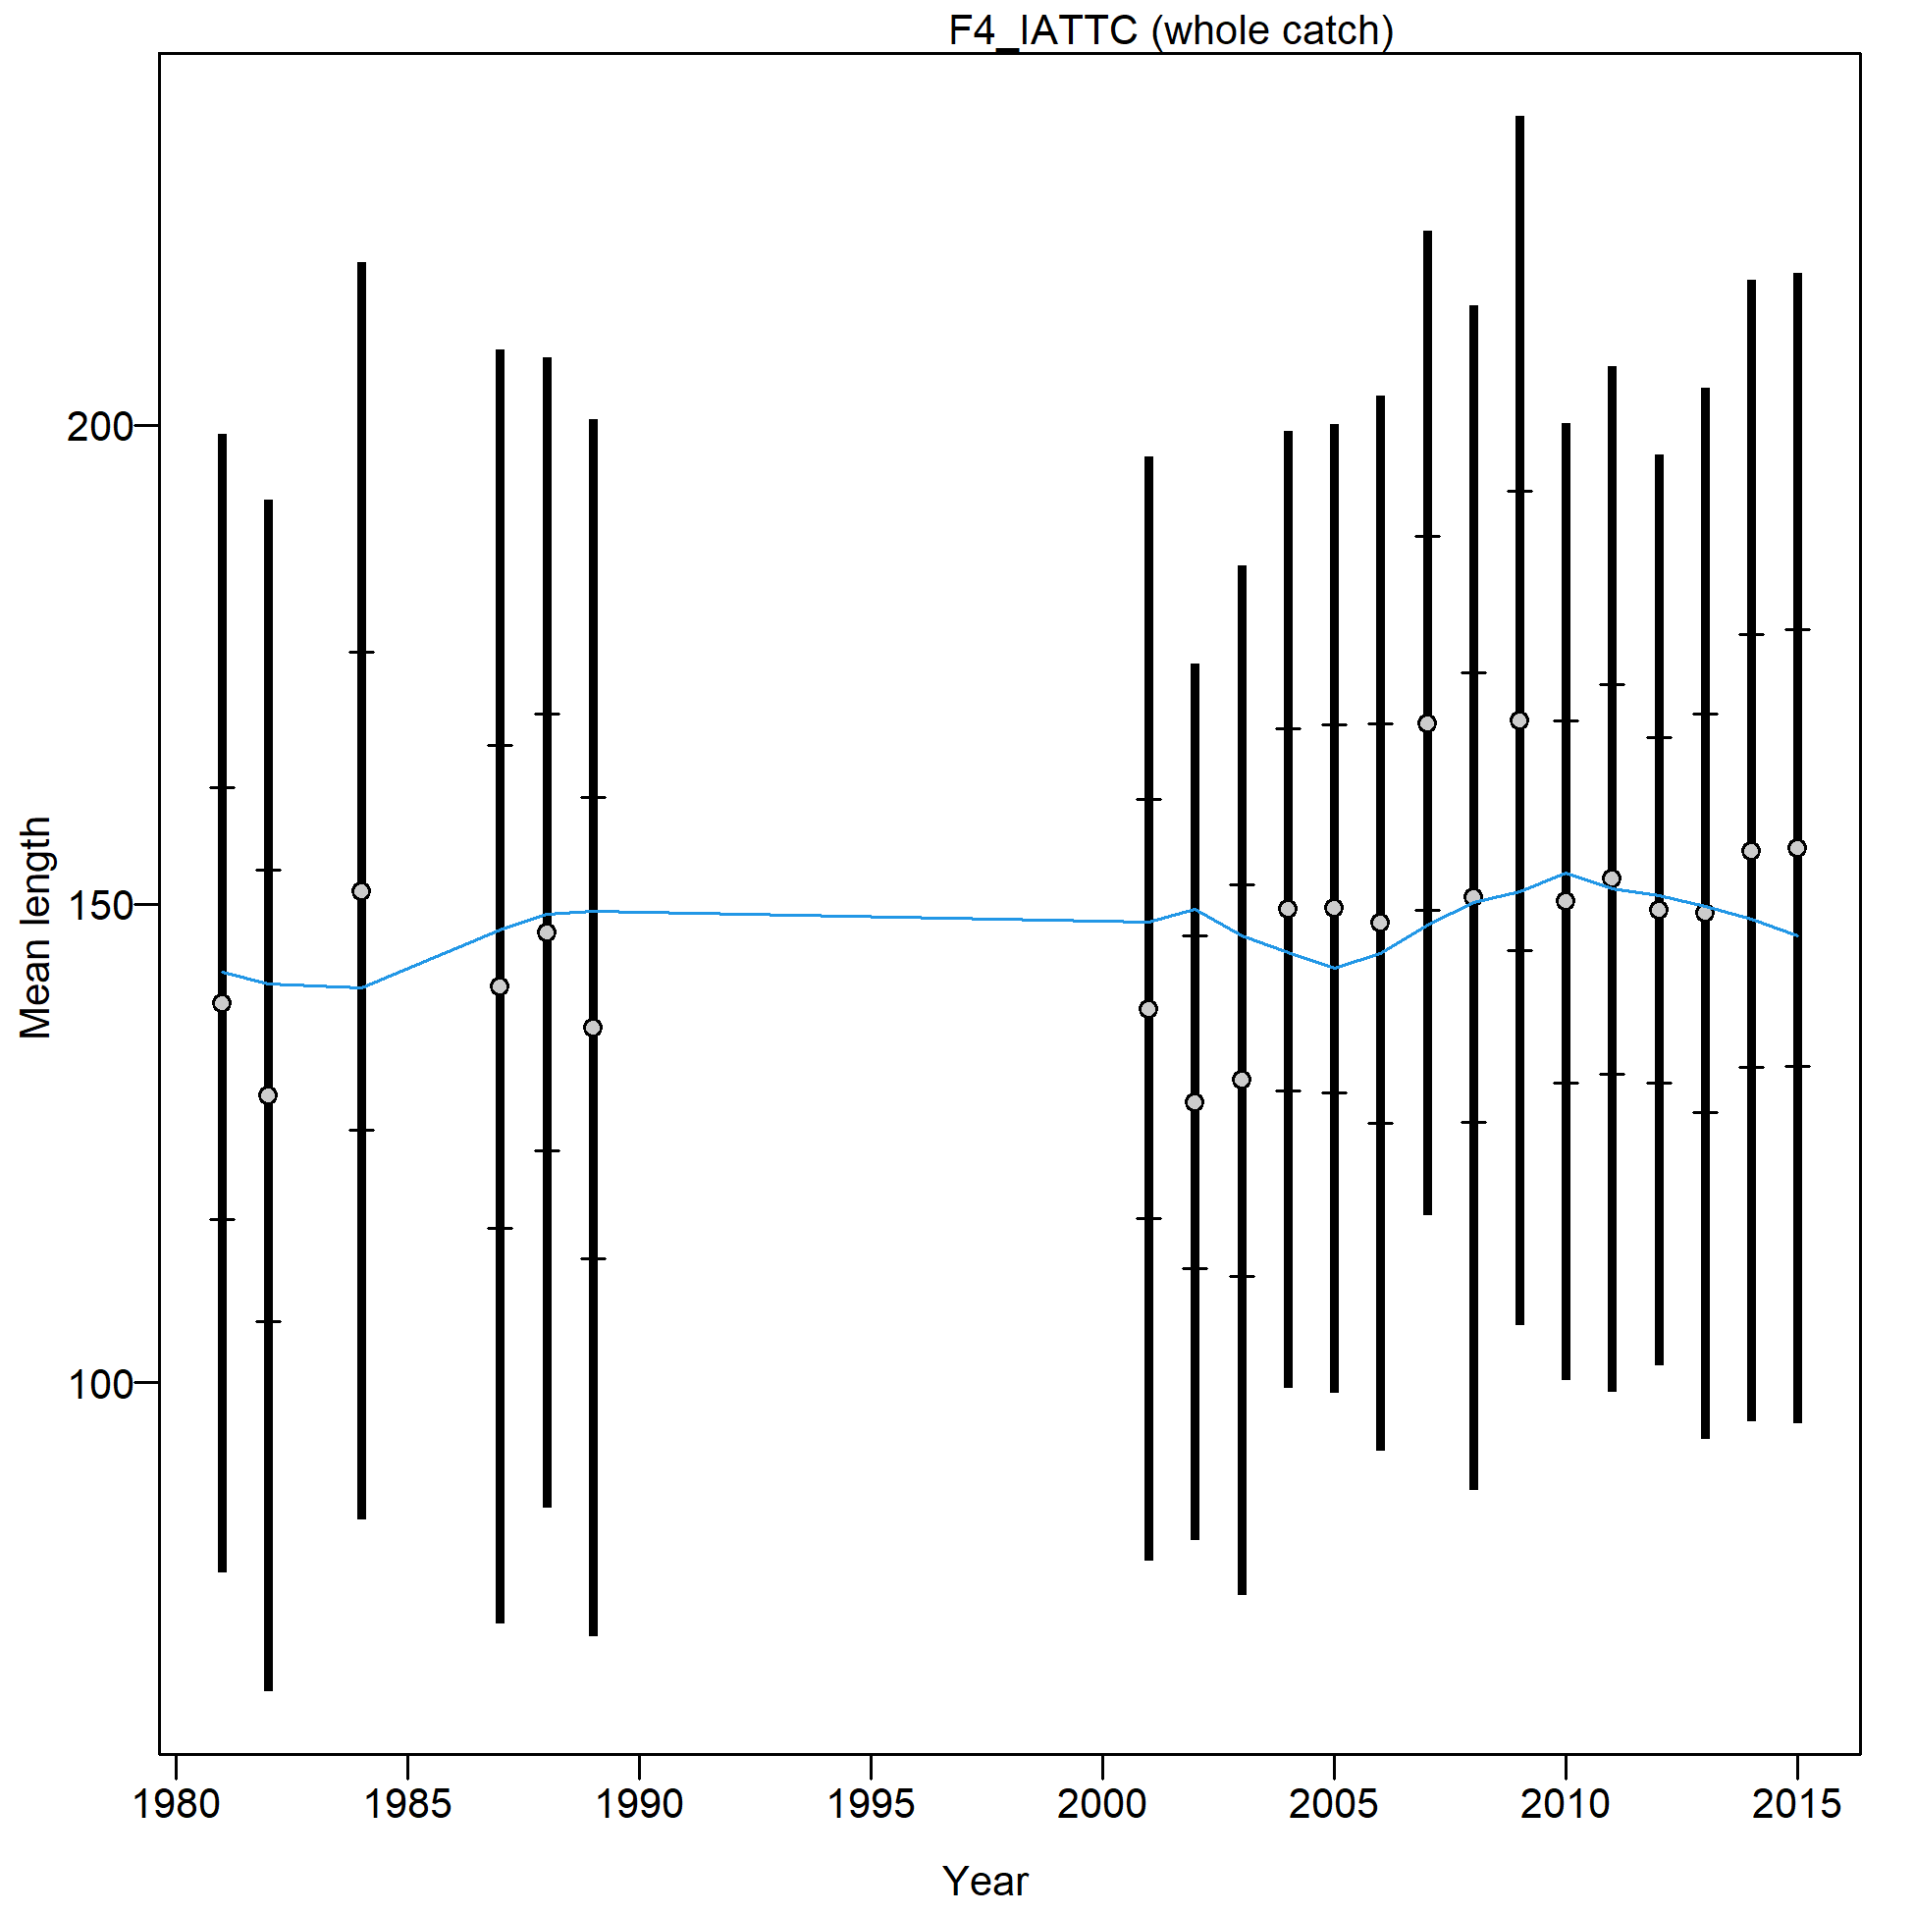
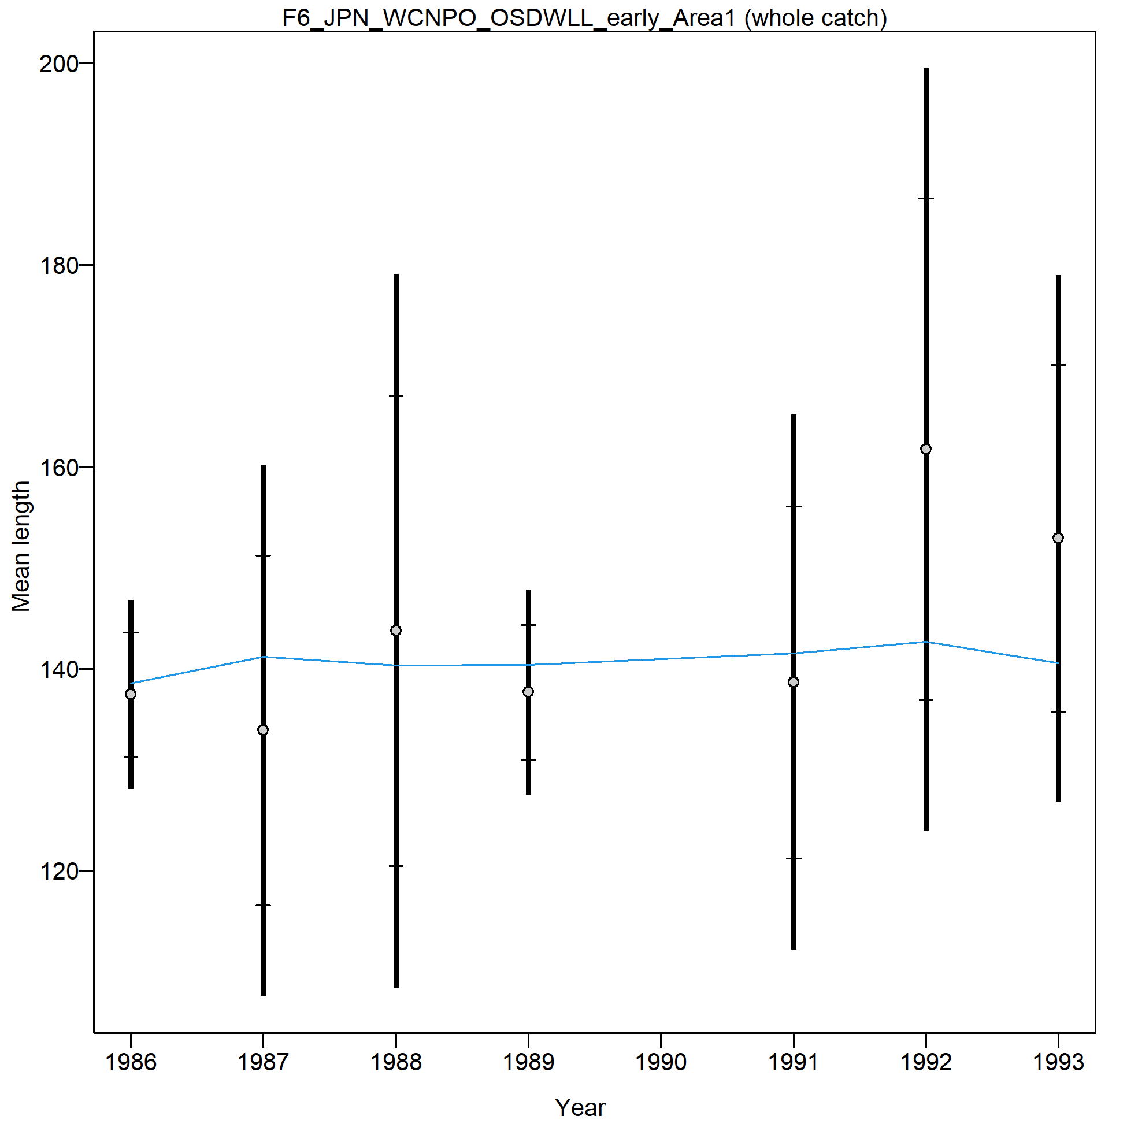
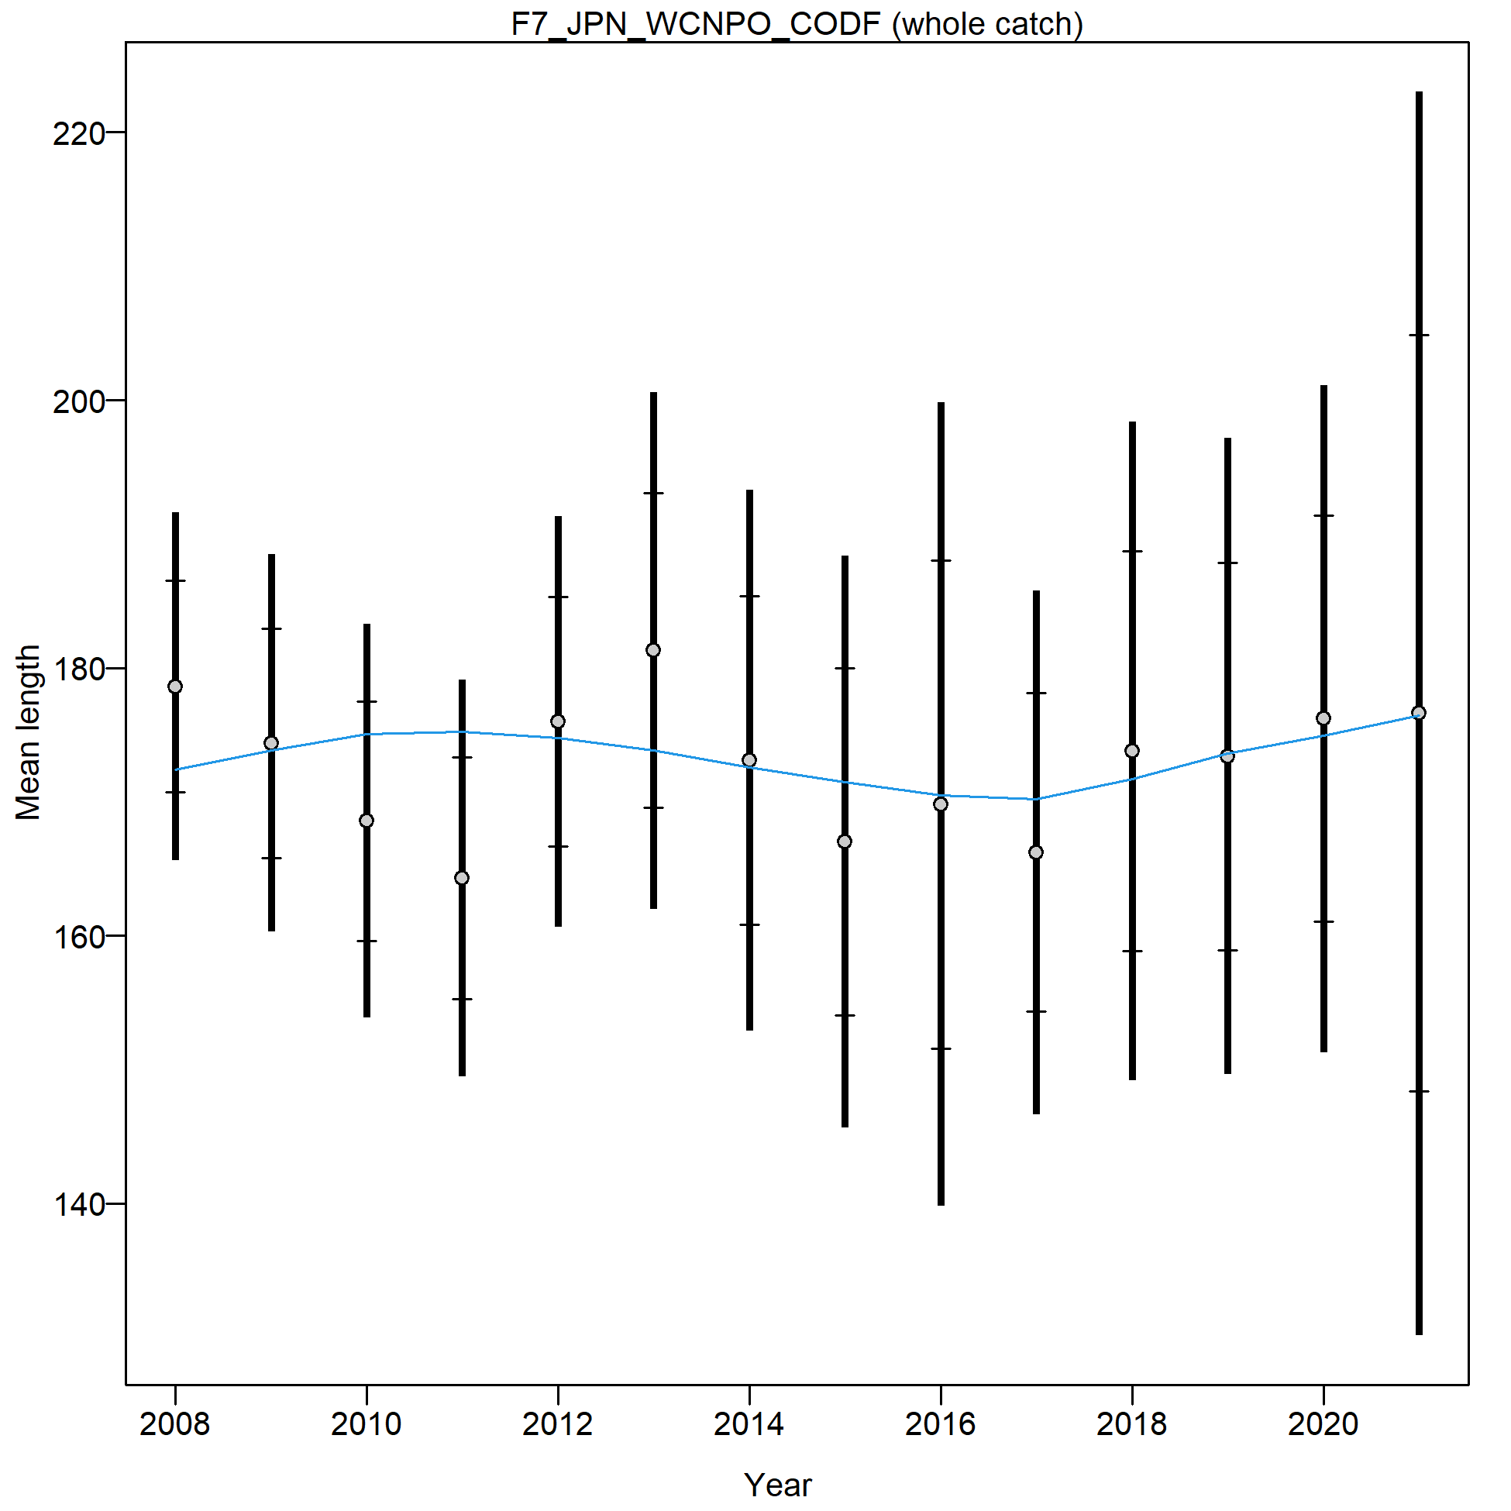
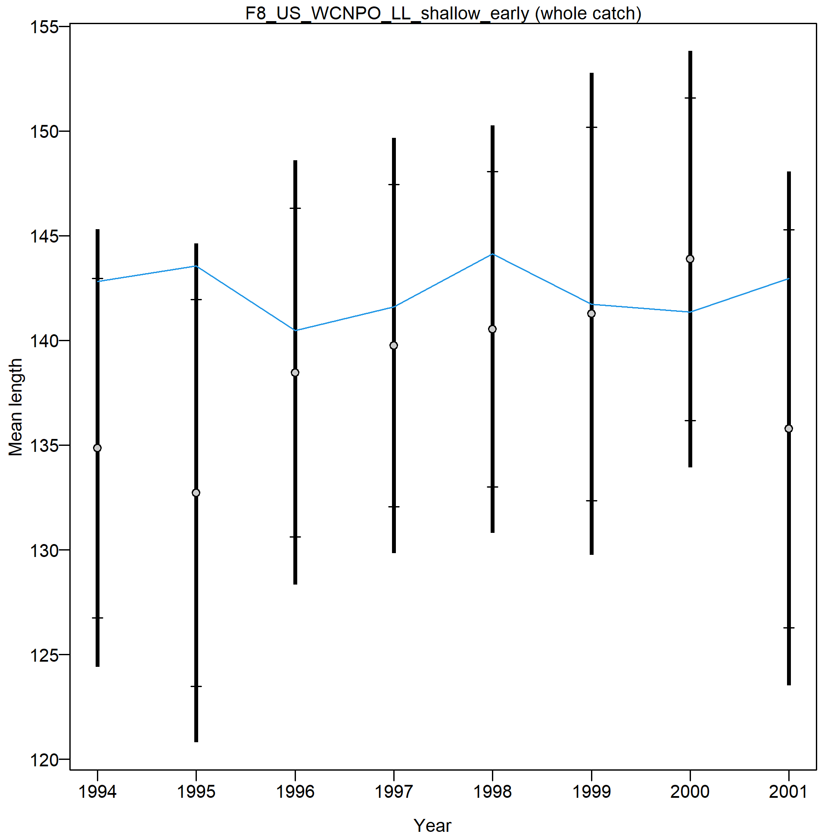
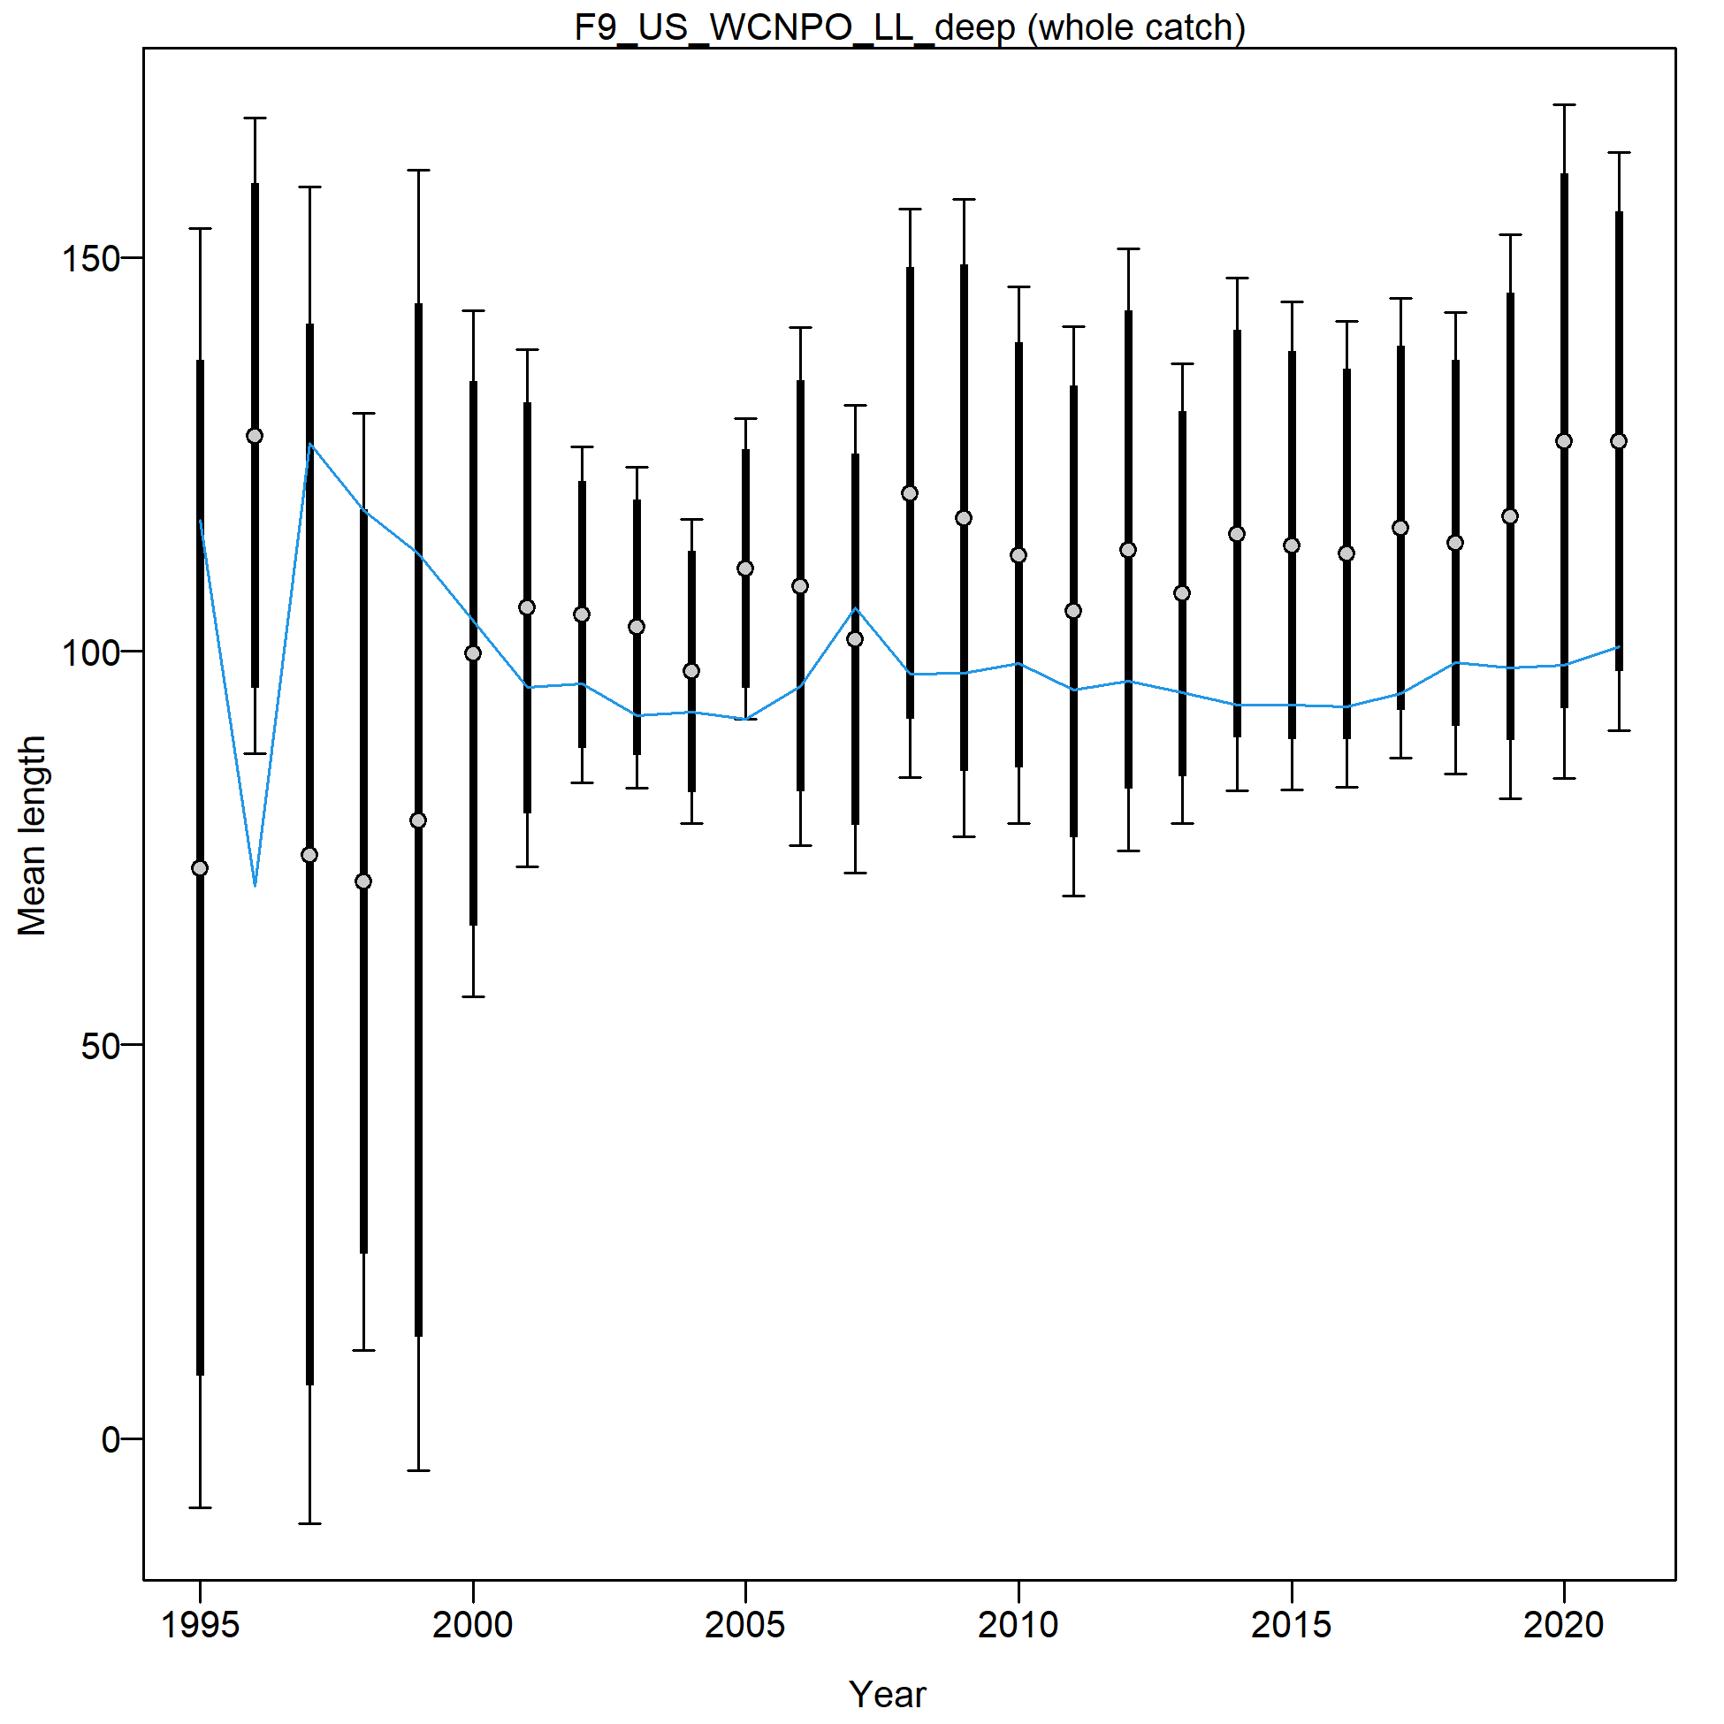

Slide 10
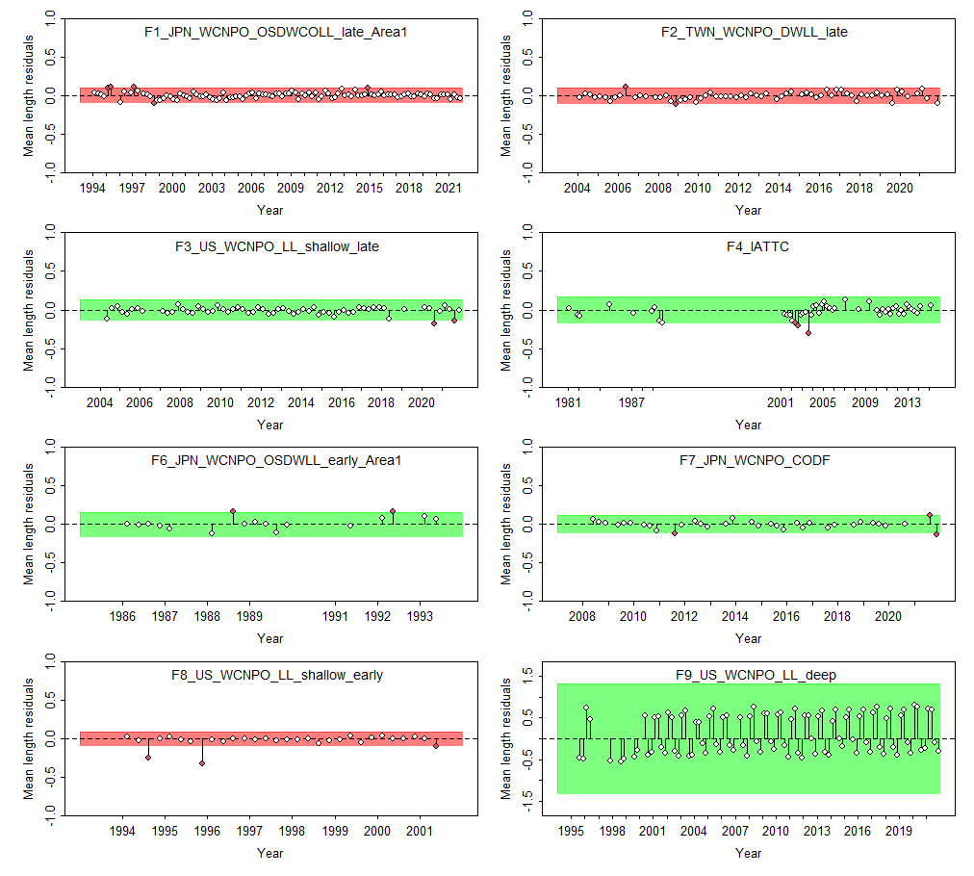

Slide 11
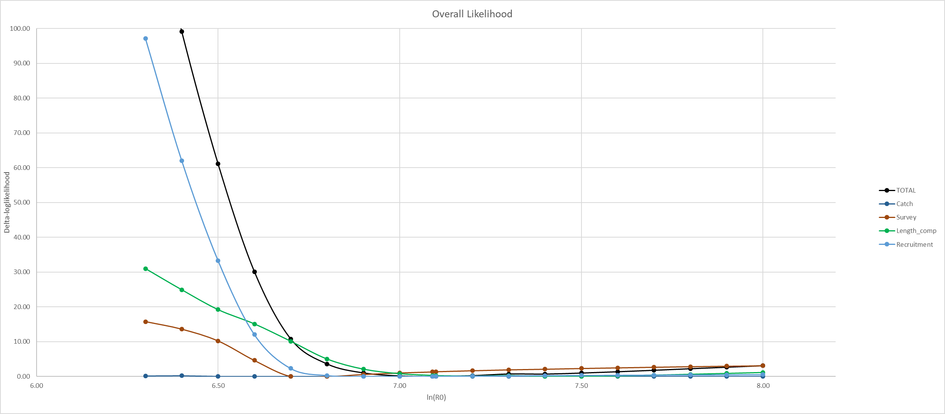
CPUE min: 6.8
Size comp min: 7.4
Rec min: 7.0

Slide 12
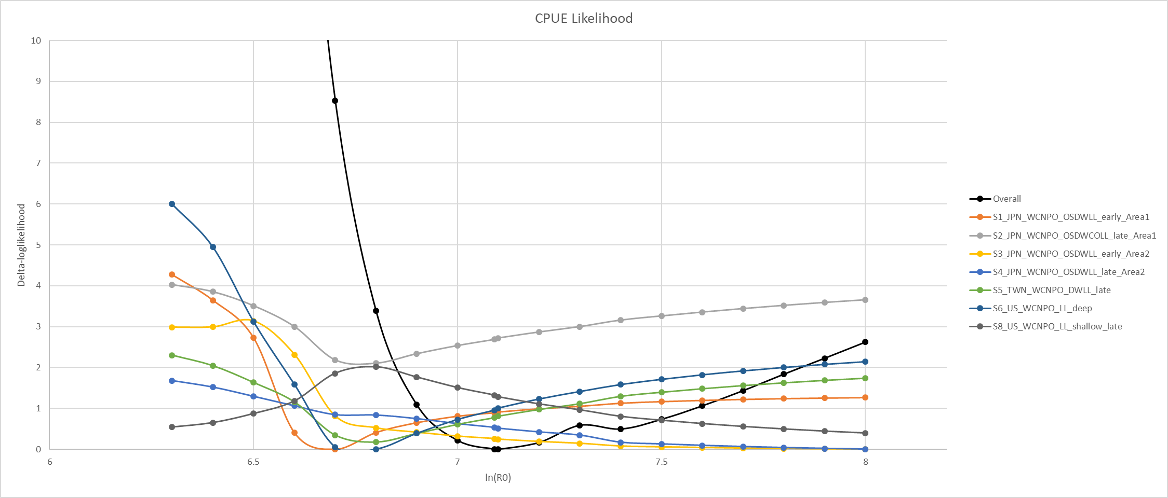

Slide 13
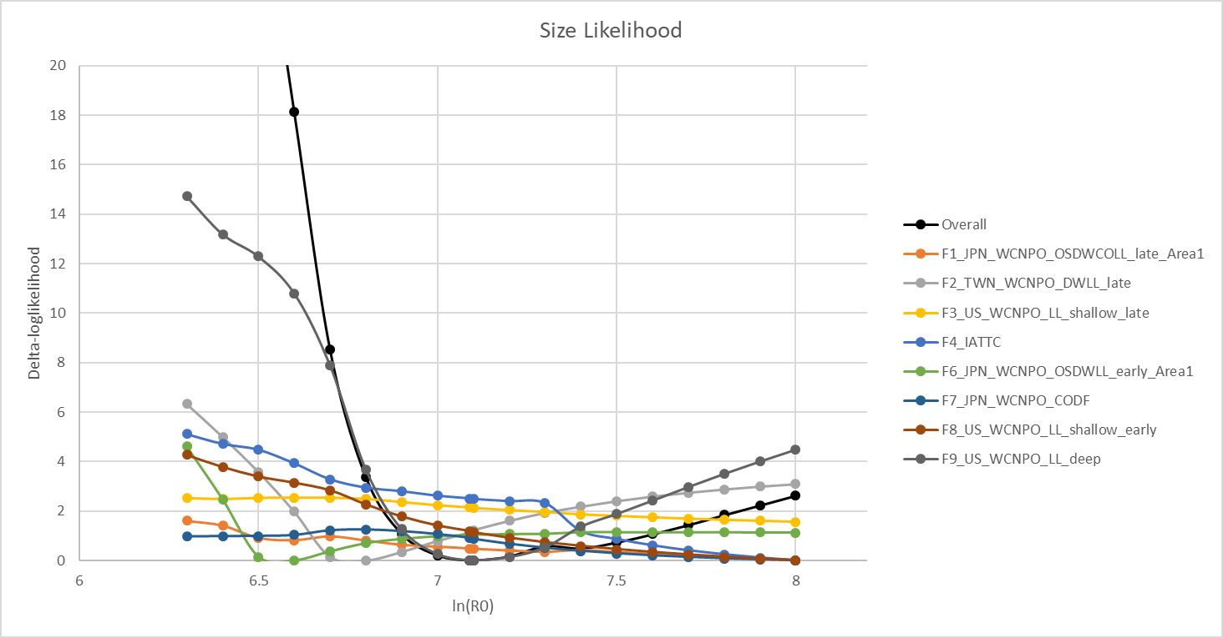
TWN DWLL and US HI LL Deep driving the size comp
Considering dropping/downweighting US deep
JPN LL Area 1 Late, IATTC, JPN LL Area 1 early, and US HI Shallow early all have very large ln(R0) – could be responsible for the model’s tendency to go to unrealistic population sizes
2018 assessment only included F1-F4, dropped all others

